Slide 1







Enterprise Blockchain Developers (Intermediate)
In support of
Powered By

Slide 2
Outline
What is Consensus
Byzantine General's Problem
What is POW
What is POS
POW VS POS
Ethereum 2.0
What is POA
Permission Layers
Code Demo
© 2017-2020 SmartMesh Foundation Pte. Ltd. | MeshBox Foundation Pte. Ltd.

Slide 3
What is Consensus?
A consensus mechanism is a fault-tolerant mechanism that is used in computer and blockchain systems to achieve the necessary agreement on a single data value or a single state of the network among distributed processes or multi-agent systems
What if there is a malicious node?
Byzantine General's Problem

Slide 4
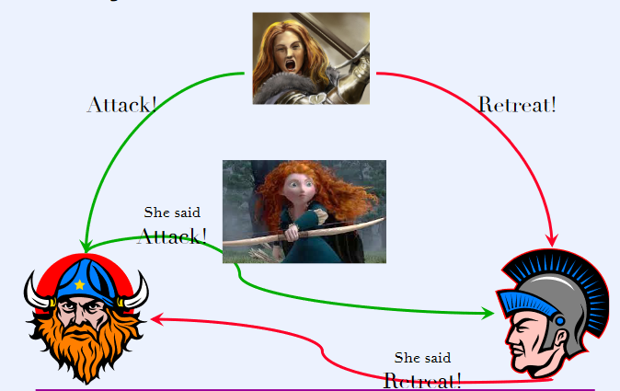
Byzantine General's Problem
if the General is malicious n = 3 t = 1

Slide 5
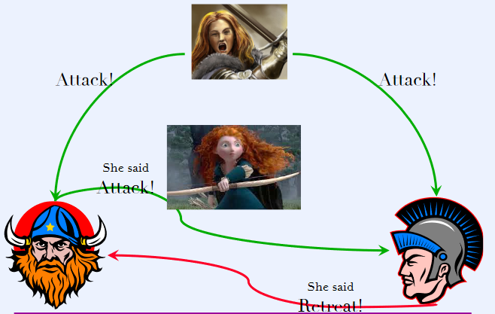
Byzantine General's Problem
if one of the lieutenant is malicious n = 3 t = 1

Slide 6
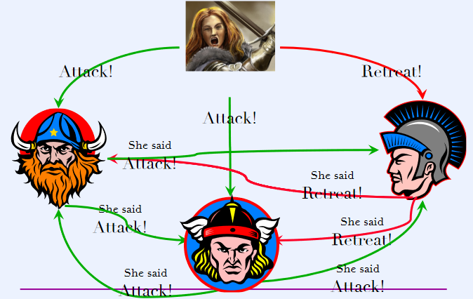
Byzantine General's Problem
if the General is malicious n = 4 t = 1

Slide 7
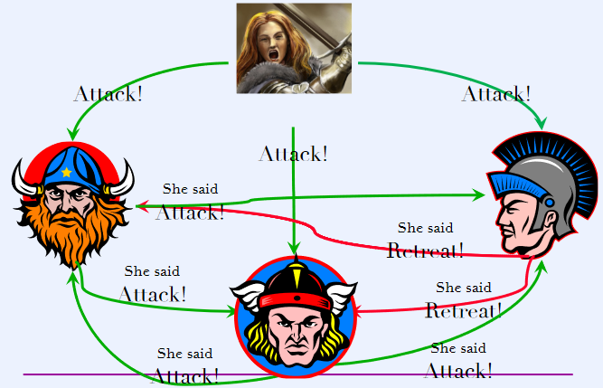
Byzantine General's Problem
if one of the lieutenant is malicious n = 4 t = 1

Slide 8
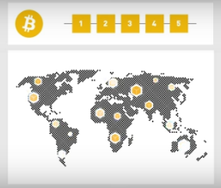
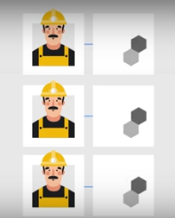
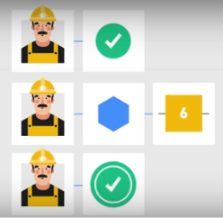
The Enlightenment of BGP and POW
What is POW?
Double Spending
n > 3t, where n is the number of nodes and t is the number of the malicious nodes, then the system is called Byzantine fault-tolerant

Slide 9
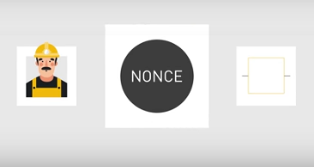
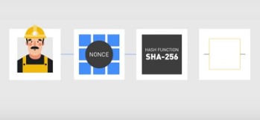
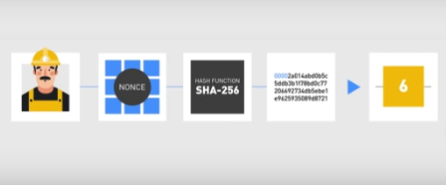
The Enlightenment of BGP and POW
What is POW? Trying to guess/bruteforce a presudo random number (aka Nonce)
When combined with data and through a hash func, it gets blockhash

Slide 10
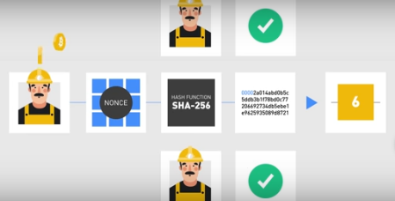
The Enlightenment of BGP and POW
Nonce and Difficuty
let’s imagine for a moment that the hashing algorithm consists of picking up a number at random from a pool of equally possible values, like in a lottery. For the sake of simplicity, let’s say that the range of the possible values goes from 0 to 100, and that we win if we pick a number that is smaller than or equal to a target T

Slide 11
What is POS?
Proof-of-stake (PoS) is a consensus algorithm for blockchain networks that is based on randomly selected validators, who “stake” the native network’s tokens by locking them into the blockchain, to produce and approve blocks. Validators are rewarded based on their total stake, incentivizing nodes to validate the network based on a return on investment (ROI).
How to do random selection?
1 Staking age
2 Randomization
3 Node's Wealth

Slide 12
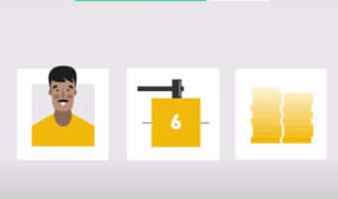
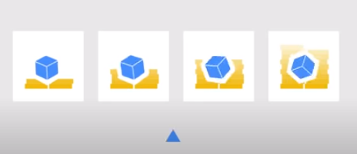
POS Mechanism
Step 1: Staking
Step 2: Ramdon Selection: Radomized Block Selection and Coin Age Selection

Slide 13
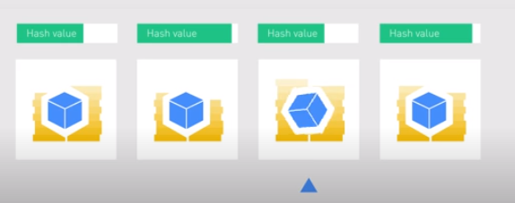
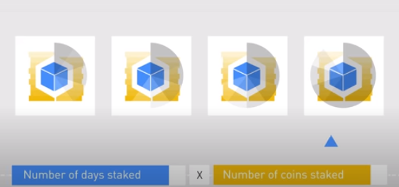
POS Mechanism
Randomized Block Selection: Lowest Hash Value and Hightest Stake (this could be predicted)
Coin Age Selection: days staked X coins numbers, when selected, age goes to zero

Slide 14
POS Mechanism
Therefore, every POS consensus mechanism could customize the the weight of this combination

Slide 15
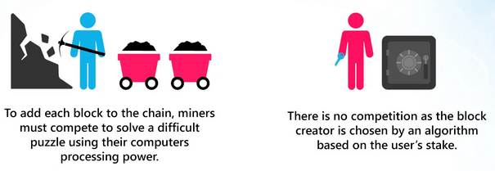
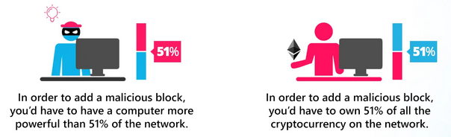
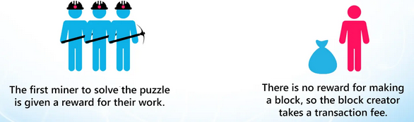
POW VS POS

Slide 16
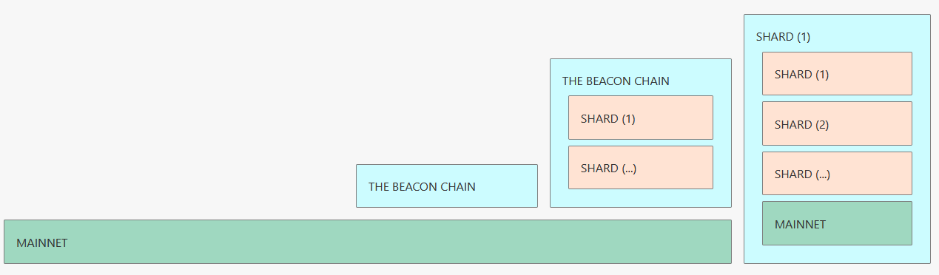
Ethereum 2.0
Phase 0: Beacon Chain: Staking
Phase 1: Sharding
Phase 2: Docking
https://launchpad.ethereum.org/checklist
https://launchpad.ethereum.org/

Slide 17
What is POA?
Proof-of-Authority is a replacement for Proof-of-Work, which can be used for private chain setups.
It does not depend on nodes solving arbitrarily difficult mathematical problems, but instead uses a set of “authorities” - nodes that are explicitly allowed to create new blocks and secure the blockchain. The chain has to be signed off by the majority of authorities, in which case it becomes a part of the permanent record. This makes it easier to maintain a private chain and keep the block issuers accountable.

Slide 18
POA Permissioning Layers
OpenEthereum provides a number of features which enable the network participants to permission different aspects of a blockchain. Often conflated as simply “permissioned blockchains” we introduce permissions on a number of different layers:
Network
Transaction type
Validator set
Gas price
Private transactions

Slide 19
POA VS POW
For consortium setting there are no disadvantages of PoA network as compared to PoW:
It is more secure (since an attacker with unwanted connection or hacked authority can not overwhelm a network potentially reverting all transactions),
less computationally intensive (mining with difficulty which provides security requires lots of computation),
more performant (Aura consensus provides lower transaction acceptance latency)
more predictable (blocks are issued at steady time intervals).
less decentralized

Slide 20
Code Demo
1 Network Control
2 Transaction Control
3 Seal blocks

